Slide 1


LECTURE 15: TOEIC Speaking Questions 7-9: Respond to questions using information provided

Slide 2

Introduction
In part 4, the student is given some background information and must answer 3 questions about it.
For example, you might see a poster for an event and be asked when the event takes place or who will be speaking. The background information stays visible while you are answering the questions.
You will have 30 seconds to read the background information, then 15 seconds each to answer the first two questions and 30 seconds to answer the final question.
Your score on each question is on a scale of 0 to 3. This is questions 7, 8, and 9.

Slide 3
Your answer will be evaluated according to the following criteria:
Intonation and Stress
Pronunciation
Grammar
Cohesion
Completeness of Content
Vocabulary
Relevance of Content

Slide 4
For question 7 and 8, which require a shorter response length (15 seconds), try the following template
- Politely acknowledge the question.
- Use a phrase for getting time to find the answer (if needed).
- Answer the question.
- Explain or give a reason (if needed).

Slide 5




Listen to the audio
Can you tell me how much it costs to attend the conference?
Certainly, sir. Let me check for more information on that. Let’s see, it looks like one-day registration will cost $235.

Slide 6
Sample Question 9
For question 9, which require a longer response length (30 seconds), try the following template
- Politely acknowledge the question.
- Use a phrase for getting time to find the first answer (if needed).
- Answer the first question.
- Give additional information or an explanation.
- Use a phrase for getting time to find the second answer (if needed).
- Answer the second question.
- Give additional information or an explanation.

Slide 7
Hmm... that's a good question. Let me see here. I've got a schedule in front of me. It looks like there's a reception for the attendees on Tuesday. That starts at 5:00 and goes until 7:00. It's in the lobby. Then on Wednesday evening there's a dinner in the main dining room. That starts at 7:30. I hope that answers your question.
Listen to the audio
What other events are happening in the evening, after the conference?

Slide 8
TIP 1: Learn useful phrases to acknowledge questions, get time to find the answers, and introduce responses.

Slide 9
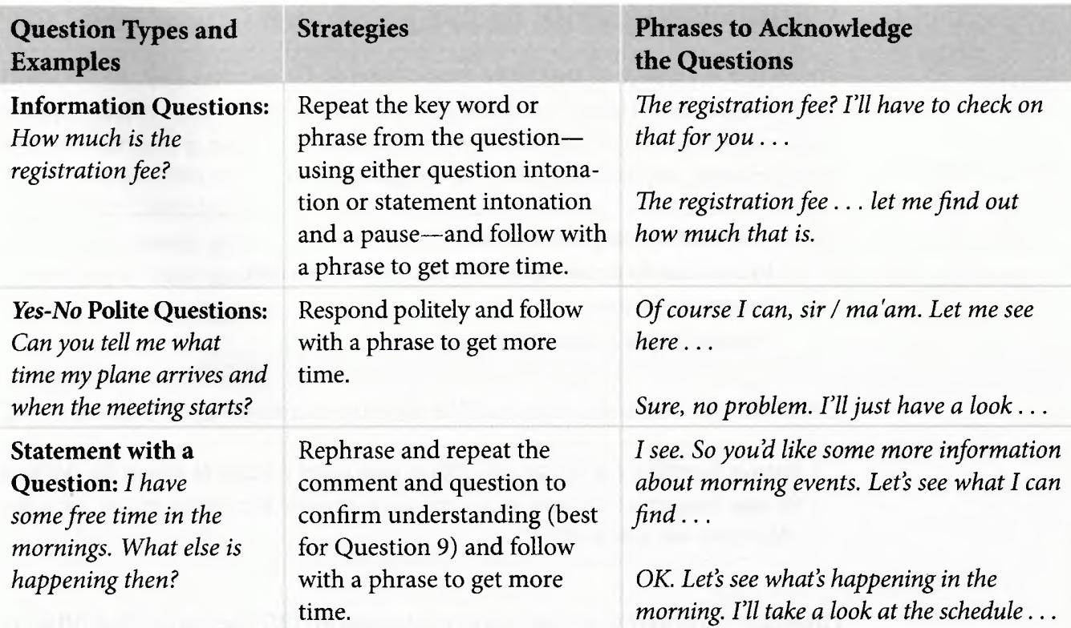
—SOMEONE FAMOUS
“This is a quote. Words full of wisdom that someone important said and can make the reader get inspired.”

Slide 10
Phrases to Get Time to Find Information
Um . . . let me check that for you. Give me just a minute to look into that, sir / ma’am. Hmm . . . I ’ll need a moment to find that information for you. Let’s see here. /Let me have a look. . . | I ’ve got a schedule /agenda /itinerary right here. I have that information right here in front o f me. Just a minute. I ’d like to check something. . . I ’m not certain. I ’ll have to look into that.
Here you could describe the topic of the section

Slide 11
Phrases for Introducing a General Response | Phrases for Introducing a No or an Unexpected Response
It looks like that’s…. It appears that X is . . . According to the schedule / agenda / itinerary. . . | I ’m really sorry, but. . . Unfortunately… I apologize, but. . . I ’m afraid that. . .

Slide 12
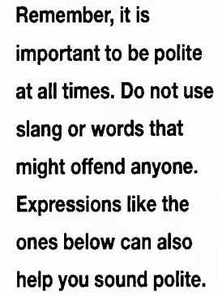
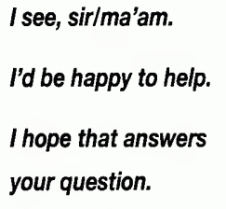
QUICK TIP

Slide 13
TIP 2: Practice talking about times, dates, locations, and costs.

Slide 14
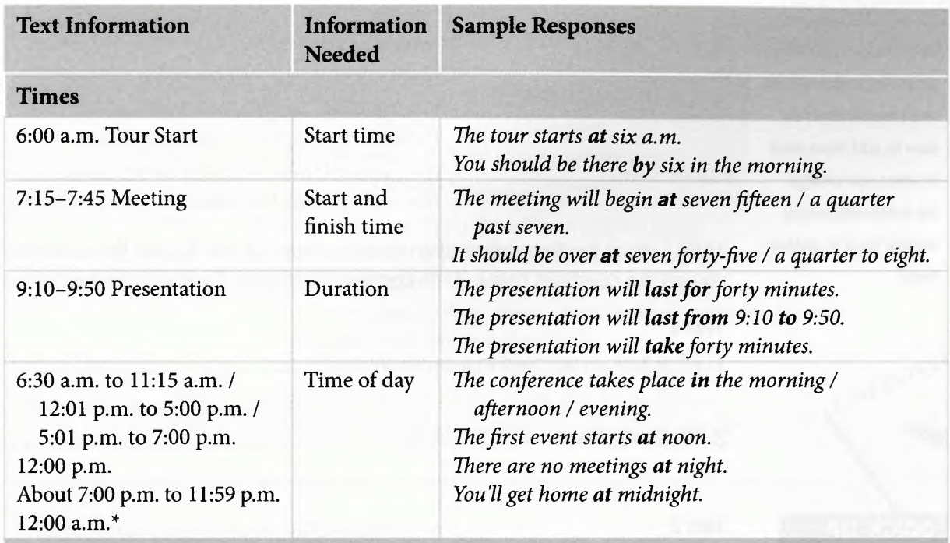

Slide 15
QUICK TIP
In some questions, you will need to say no to a request. When this happens, try to explain why the request can’t be met. Use expressions like these.
I’m sorry. That’s not possible because. . .
We’d really like to help, but we can’t. The reason is . . .

Slide 16
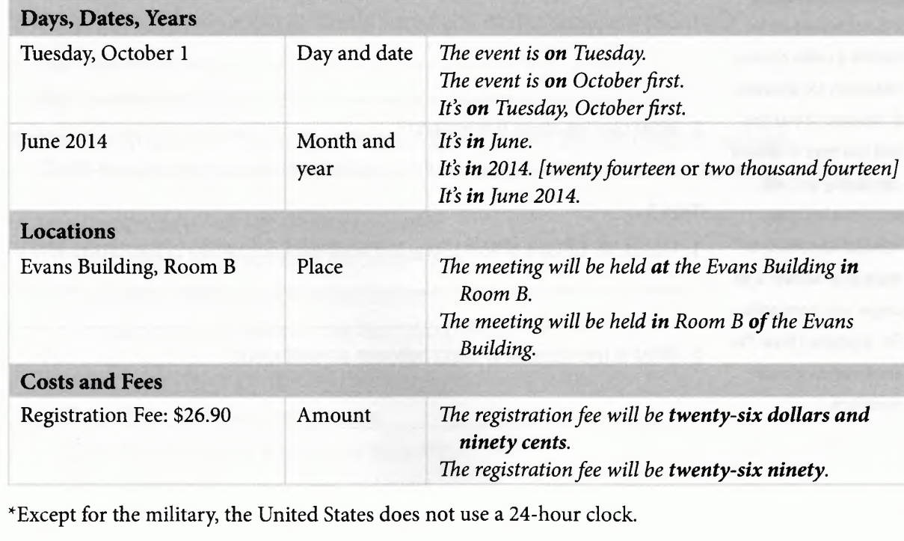

Slide 17
QUICK TIP
Practice different ways to say times. For 7:00 p.m., most English speakers will say seven p.m. rather than the longer, considerably more formal seven o’clock p.m. You could also say seven in the evening because the use of p.m. means the event takes place in the evening or at night.

Slide 18
Some helpful grammatical forms

Slide 19
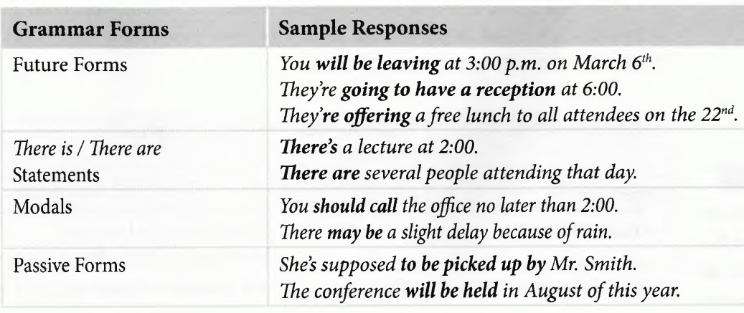

Slide 20
Use the information in the texts to answer the questions below. Write complete sentences. Then practice saying answers out loud.
Drilling Site Tour
Daily at 11:00 a.m. No tours on weekends.
Safety equipment required for all participants!
10:45 a.m. Meet at tunnel entrance
11:00-12:00 Walking tour (with guide) of finished part of the tunnel.
12:00-1:00 Lunch in underground break room
1:00-1:30 Talk about drill site safety
1:30-2:30 Open viewing of drill area (guide available)
3:00 Return to base camp

Slide 21
A Scan the schedule. What is the information mostly about?
Barkbury International, Inc.
Itinerary for the visit of Mr. Ronald Green of the London office to New York headquarters,
April 15-16,2012
April 15:
5:00 p.m. Arrive at airport; transfer to Hotel Dominion by company car
7:00 p.m. Dinner with CEO Alex Chavez, Hotel Dominion Dining Room

Slide 22
April 16
10:00 a.m. Breakfast meeting with Marketing Director Jane Fisher, Conference
Room 15
12:00p.m. Lunch and meeting with Board of Directors, Pearl Restaurant
4:00 p.m. Reception for all office staff, Hotel Dominion Reception Room
7:00 p.m. Private tour of the City Museum of Art
9:00 p.m. Return to hotel
The information is an itinerary for Mr. Green’s visit to the New York headquarters.

